Slide 1
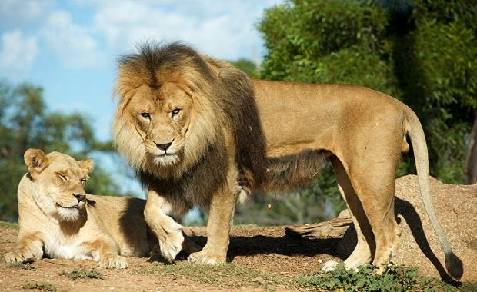
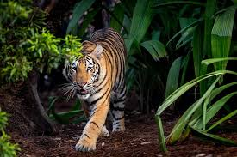
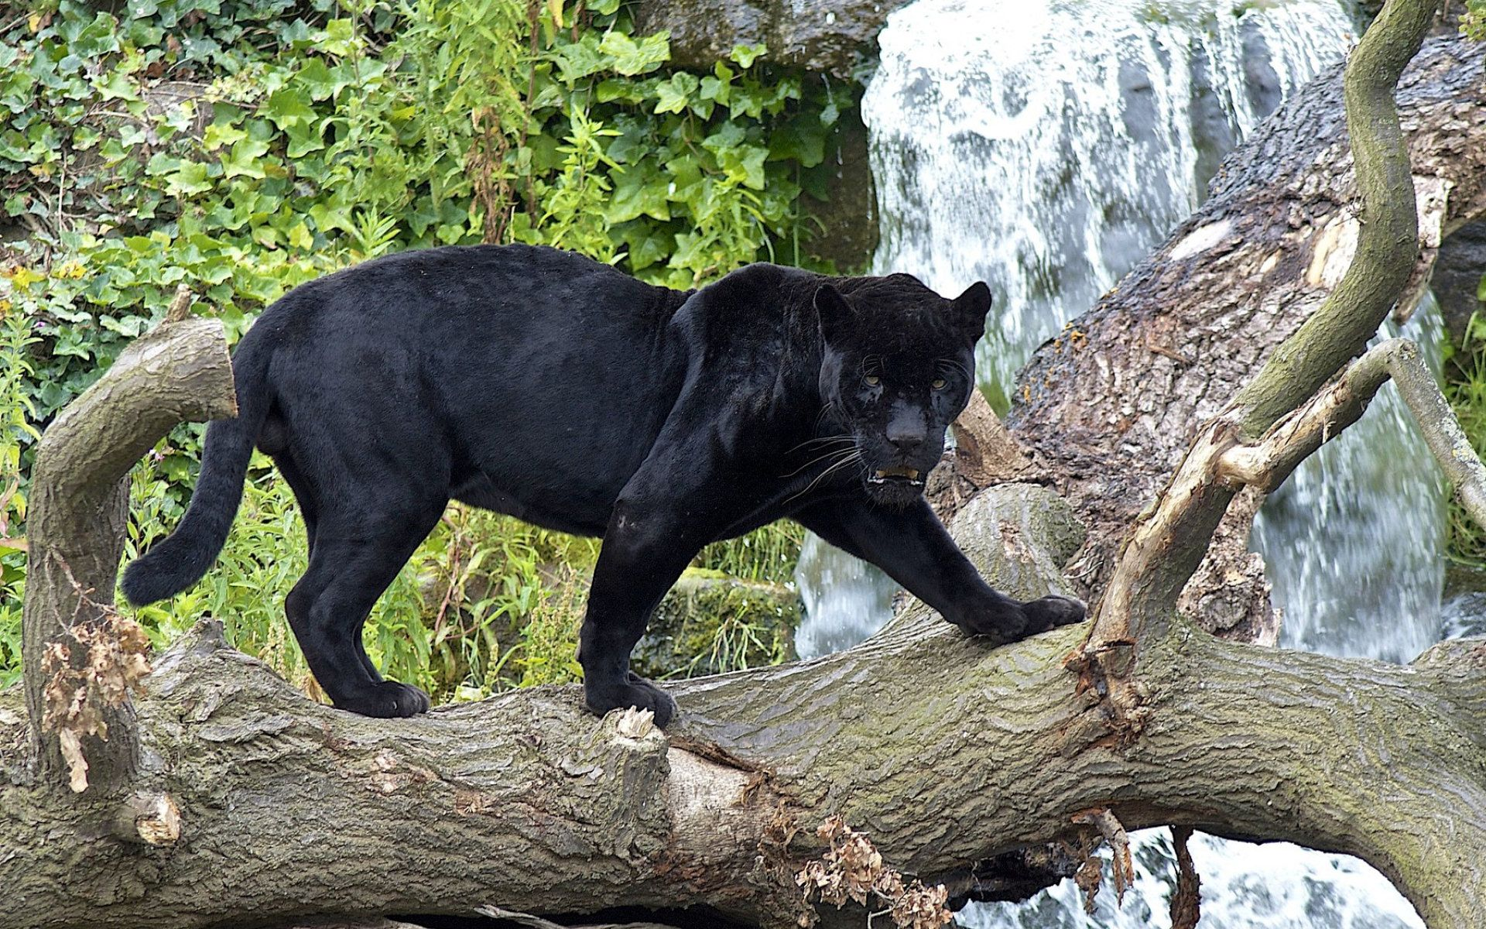
Daily Review
A characteristic is a feature of an object.
On your whiteboard, list 3 characteristics these animals have in common.
On your whiteboard, list 2 characteristics that are different between the animals.

Slide 2
Classification Keys

Slide 3
Learning Objectives
CFU
What are we going to learn?
Define dichotomous keys.
Use branched and tabular keys to identify organisms or objects.
Activate Prior Knowledge
In a large shop like Target or Big W, the items for sale are organised into groups or categories.
Think, pair, share: What are some of the sections in Target or Big W?
Think, pair, share: If you wanted to find a pair of socks, how would you do it?

Slide 4
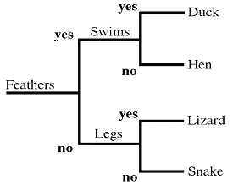
Concept Development
CFU 1
What is a dichotomous key?
Dichotomous Keys
A dichotomous key is a visual tool used to classify organisms.
Dichotomous means ‘divide into two’.
Each branch of the key splits into two.
CFU 2
How many options does each branch have?
CFU 3
What characteristics are used to separate the organisms in this key?

Slide 5
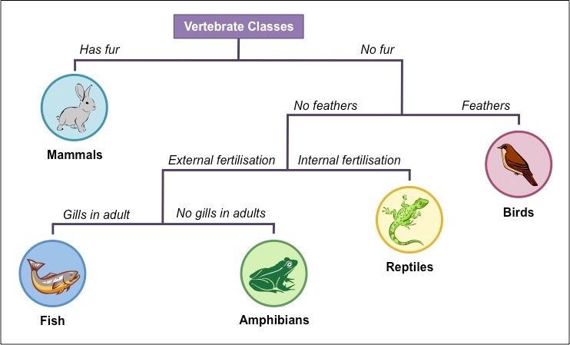
Concept Development
CFU 1
What does a branched key look like?
Branched Keys
A branched key looks a bit like a tree
They show where a particular organism fits in the group
CFU 2
How many options does each branch have?
CFU 3
What characteristics are used to separate the fish and the amphibians?
CFU 4
What characteristics does the bird have?

Slide 6
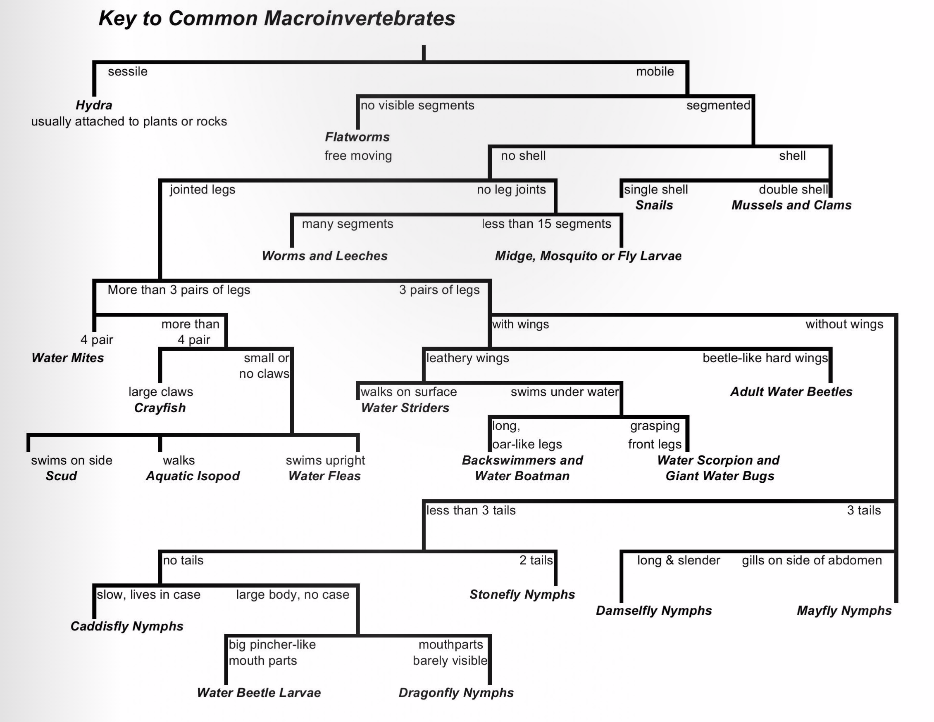
Branched keys can become very large and unmanageable as more organisms are added.

Slide 7
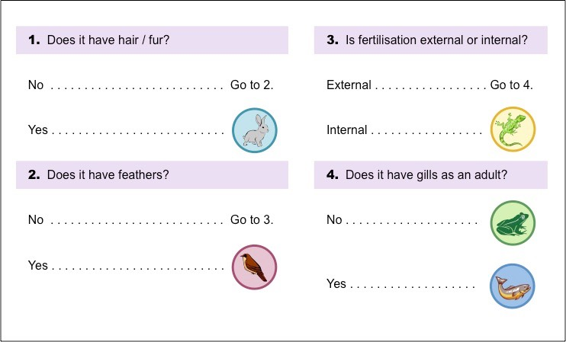
Concept Development
Tabular Keys
Tabular keys are written as a list.
They contain the same information, but take up less space.
Scientists often use tabular keys when doing fieldwork.
CFU 3
In this tabular key, what characteristics are used to separate the organisms?
CFU 1
How is a tabular key the same as a branched key?
CFU 2
How is a tabular key different to a branched key?
CFU 4
What characteristics does the frog have?

Slide 8
Concept Development
CFU 1
What do characteristics in a key need to be?
Characteristics in Keys
Characteristics used in keys need to be constant, observable and measureable.
Big or small is not a good characteristic to use because it is too vague.
Smaller than 10cm or larger than 10cm is a good characteristic to use because it is specific.
CFU 2
Is ‘tail longer than 15cm’ a good characteristic? Explain your choice.
CFU 3
Is ‘hair in a ponytail’ a good characteristic? Explain your choice.

Slide 9
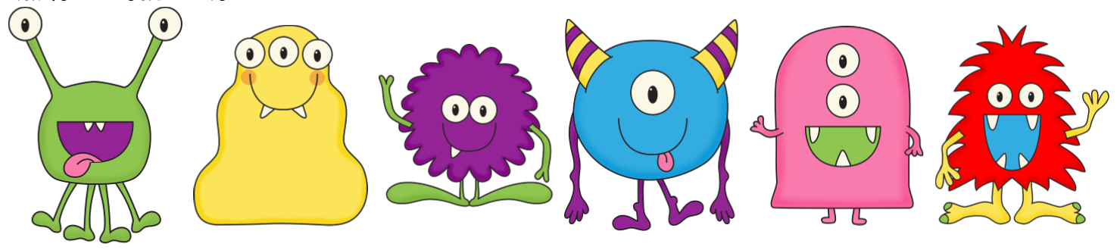
Skill Development/Guided Practice
Aliens
Using Branched Dichotomous Keys
Look at the first choice
Decide which option is true and follow the arrow
Look at the new choice
Decide which option is true and follow the arrow
Keep going until you reach the creature’s name
Open mouth
Closed mouth
Arms
No arms
No horns
Horns
Hairy
Not hairy
Alienus quadlegius
No legs
Legs
Alienus stripicus
Alienus haricus
Alienus tritoothicus
Alienus blobicus
Alienus fuzzicus
What is the name of this alien?
It has an open mouth and no arms, so it is called Alienus quadlegius.

Slide 10
Skill Development/Guided Practice
Aliens
Using Branched Dichotomous Keys
Look at the first choice
Decide which option is true and follow the arrow
Look at the new choice
Decide which option is true and follow the arrow
Keep going until you reach the creature’s name
Open mouth
Closed mouth
Arms
No arms
No horns
Horns
Hairy
Not hairy
Alienus quadlegius
No legs
Legs
Alienus stripicus
Alienus haricus
Alienus tritoothicus
Alienus blobicus
Alienus fuzzicus
What is the name of this alien?
It has a closed mouth, no horns and no legs, so it is called Alienus blobicus.

Slide 11
Skill Development/Guided Practice
Aliens
Using Branched Dichotomous Keys
Look at the first choice
Decide which option is true and follow the arrow
Look at the new choice
Decide which option is true and follow the arrow
Keep going until you reach the creature’s name
Open mouth
Closed mouth
Arms
No arms
No horns
Horns
Hairy
Not hairy
Alienus quadlegius
No legs
Legs
Alienus stripicus
Alienus haricus
Alienus tritoothicus
Alienus blobicus
Alienus fuzzicus
What is the name of this alien?
It has an open mouth, arms and is not hairy, so it is called Alienus tritoothicus.

Slide 12
Skill Development/Guided Practice
Using Tabular Dichotomous Keys
Look at the first choice
Decide which option is true and follow the directions
Look at the new choice
Decide which option is true and follow the directions
Keep going until you reach the creature’s name
1 a. Mouth open …..… Go to 2
b. Mouth closed ...... Go to 4
2 a. Arms ………………… Go to 3
b. No arms ……..….… Alienus quadlegius
3 a. Hairy ………………... Alienus hairicus
b. Not hairy ………….. Alienus tritoothicus
4 a. No horns ……….…. Go to 5
b. Horns …………..…… Alienus stripicus
5 a. No legs …….…….… Alienus blobicus
b. Legs ….……………... Alienus fuzzicus
What is the name of this alien?
It has a closed mouth, no horns and legs, so it is called Alienus fuzzicus.

Slide 13
Skill Development/Guided Practice
Using Tabular Dichotomous Keys
Look at the first choice
Decide which option is true and follow the directions
Look at the new choice
Decide which option is true and follow the directions
Keep going until you reach the creature’s name
1 a. Mouth open …..… Go to 2
b. Mouth closed ...... Go to 4
2 a. Arms ………………… Go to 3
b. No arms ……..….… Alienus quadlegius
3 a. Hairy ………………... Alienus hairicus
b. Not hairy ………….. Alienus tritoothicus
4 a. No horns ……….…. Go to 5
b. Horns …………..…… Alienus stripicus
5 a. No legs …….…….… Alienus blobicus
b. Legs ….……………... Alienus fuzzicus
What is the name of this alien?
It has a closed mouth and horns, so it is called Alienus stripicus.

Slide 14
Skill Development/Guided Practice
Using Tabular Dichotomous Keys
Look at the first choice
Decide which option is true and follow the directions
Look at the new choice
Decide which option is true and follow the directions
Keep going until you reach the creature’s name
1 a. Mouth open …..… Go to 2
b. Mouth closed ...... Go to 4
2 a. Arms ………………… Go to 3
b. No arms ……..….… Alienus quadlegius
3 a. Hairy ………………... Alienus hairicus
b. Not hairy ………….. Alienus tritoothicus
4 a. No horns ……….…. Go to 5
b. Horns …………..…… Alienus stripicus
5 a. No legs …….…….… Alienus blobicus
b. Legs ….……………... Alienus fuzzicus
What is the name of this alien?
It has an open mouth, arms and is hairy, so it is called Alienus hairicus.

Slide 15
Relevance
Everyday, we classify objects into groups in many different ways.
Understanding simple dichotomous keys will help you understand how organisms are grouped together using their similarities and differences.

Slide 16
Skill Closure
Use the branched key to identify the objects below:
All Objects
Round
Square
Skill Closure
Spots
Stripes
Spots
Stripes
Big
Small
Big
Small
Big
Small
Big
Small
Draw a glap and a snef.
Glap Glop Werp Derp Flub Trub Neft Snef
Skill Closure
Which characteristic in the key is not a good characteristic to use? Explain your choice.

Slide 17
Independent Practice
Complete the ‘Planet Pamishan’ worksheet by using the tabular key to identify the creatures on planet Pamishan.

